Slide 1
Banking System Project
Developed by Sai Thota
Java | MySQL | Maven | JUnit 5 | Log4j

Slide 2
Project Objective
The objective of the Banking System Project is to design and implement a robust, database-driven application that simulates core banking operations such as account management, customer handling, transactions, loans, and administrative control.
The system aims to provide a secure, efficient, and scalable platform that automates routine banking processes, ensures data consistency through real-time MySQL database integration, and supports modular architecture through the DAO and service layers.
This project demonstrates practical implementation of object-oriented principles, JDBC connectivity, and unit testing using JUnit 5 to ensure reliability and maintainability of the entire banking workflow.

Slide 3
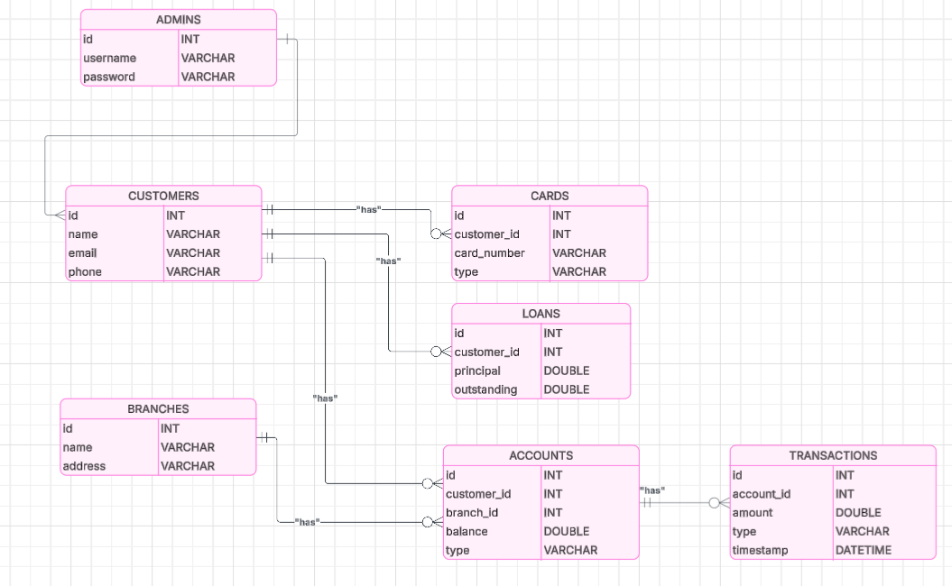
ER Diagram

Slide 4
System Architecture
DAO Layer - Handles all database operations (AccountDAO, CustomerDAO, etc.)
Service Layer - Implements business logic and transactional rules
UI Layer - Console interface for user interaction
Utility Layer - DBConnection, LoggerUtil, UIUtil

Slide 5
Technology Stack
Java 23 (Core + JDBC)
MySQL Database (banking_db)
Maven Build Tool
Log4j for Logging
JUnit 5 for Testing

Slide 6
Core Features
Account Management (Create, Update, Delete, View)
Customer Management (Add, Edit, Search)
Transaction Operations (Deposit, Withdraw, Transfer)
Loan and Card Modules
Admin and Branch Operations
Secure Login and Dashboard

Slide 7
Banking Logic – Transaction Flow
Handles Deposits, Withdrawals, and Transfers
Maintains consistent balances across accounts
Supports Loan Repayment and Card Billing
All operations logged through Log4j

Slide 8
Reports & Analytics
Real-time console-based reports
Transaction summaries and logs
Account balance reports
Branch and account type summaries

Slide 9
Testing & Logging
JUnit 5 integration tests for all services
Real MySQL database connectivity in tests
Automatic data setup and cleanup for testing
Log4j tracks all major events and errors

Slide 10
Database Schema & Design
Tables: customer, account, transaction, loan, card, branch, admin
Relationships: Customer ↔ Account ↔ Transaction
Foreign Key constraints for referential integrity
MySQL JDBC Driver used for connection

Slide 11
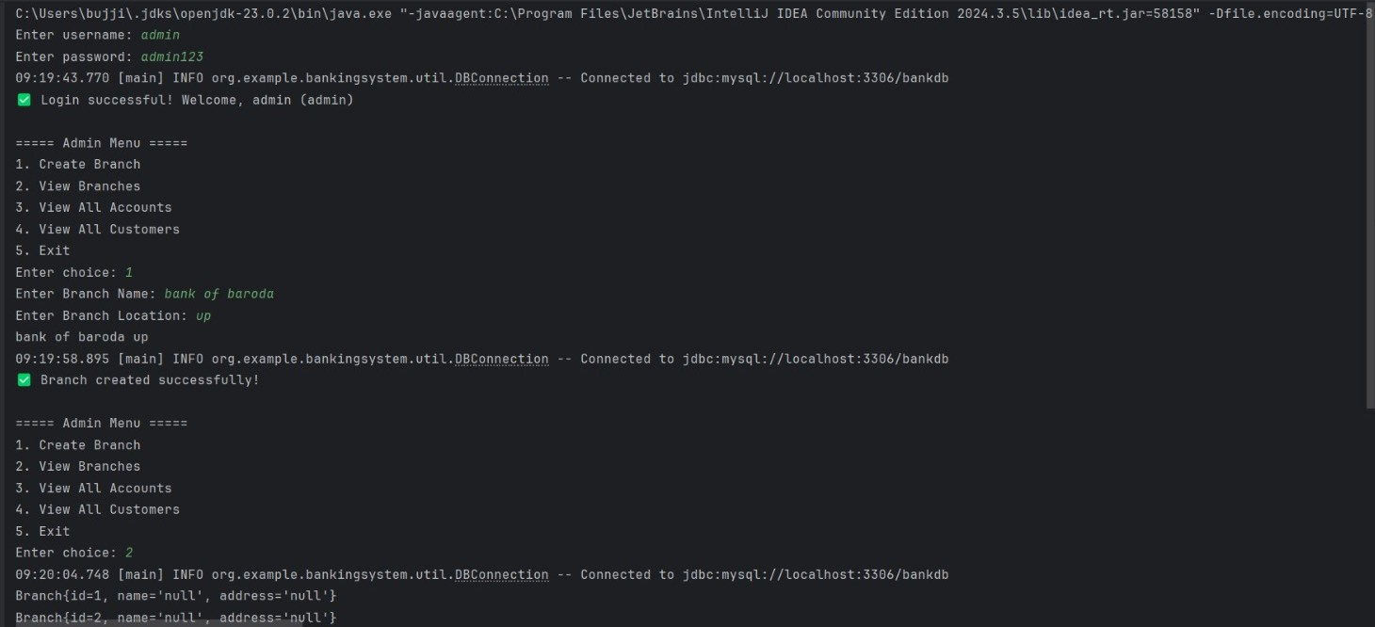
Console Output

Slide 12
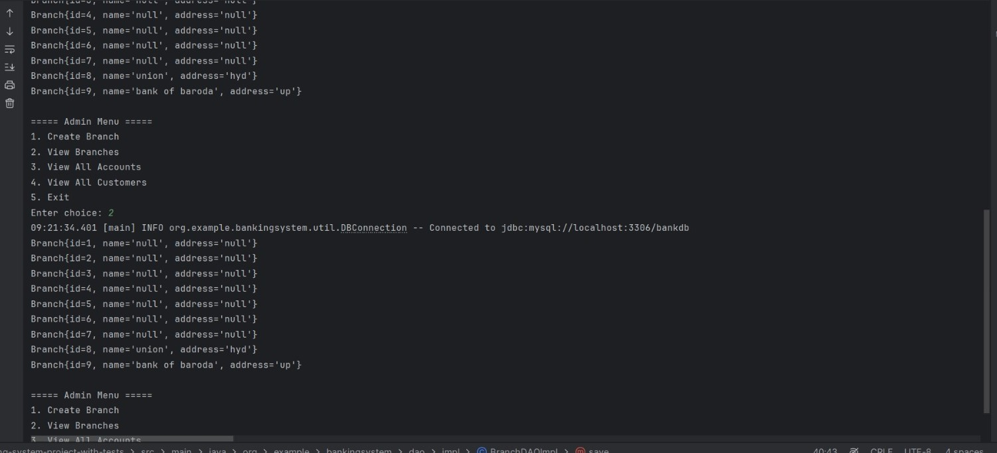

Slide 13
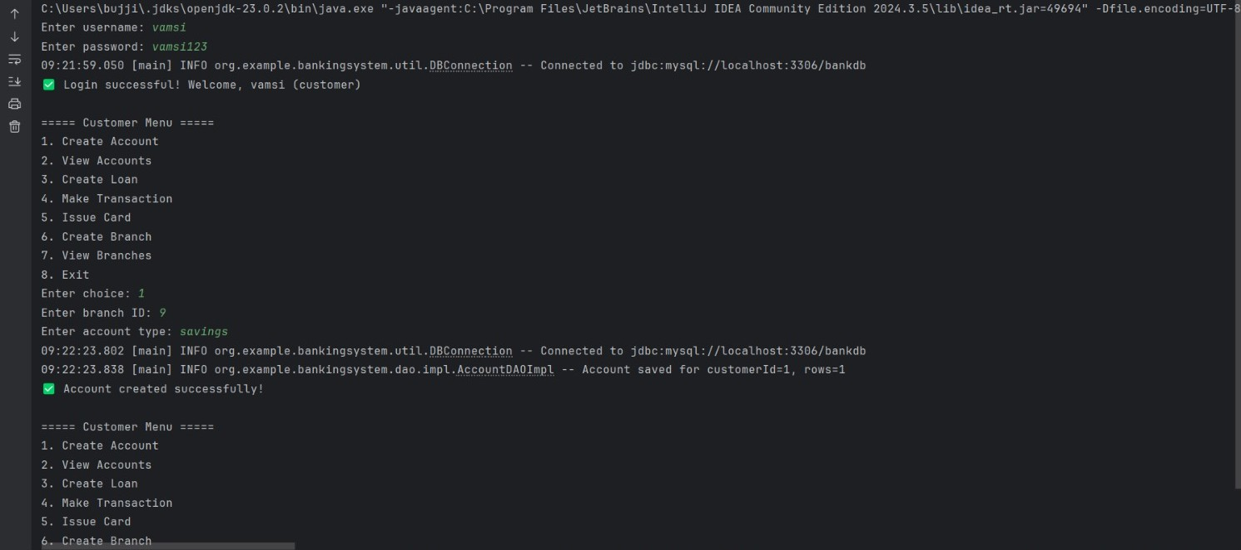

Slide 14
Conclusion & Viva Summary
Console-based Java Banking System with modular design
Layered architecture ensures scalability and maintainability
Persistent MySQL database for real data storage
Comprehensive JUnit 5 tests ensure reliability
Future-ready for web migration (Spring Boot, REST APIs)

Slide 15
Thank You

